Slide 1

Carbon Nanotubes
Towards the Next _Generation of Enzyme Biosensors

Slide 2
1. Introduction
Enzymatic Biosensors- One of the opportunities that nanomaterials provides is a more efficient way of communicating the activity of biological molecules used in biosensors.
This communication is achieved via the transfer of electrons.
In the case of many devices, electrons must be transferred between redox protein and an electrode over which the proteins are immobilized.
This communication between redox proteins and electrodes can be further improved using carbon nanotubes.
Efficient transfer of electrons will result in improved biosensing and bioelectronic devices.
Example: Enzyme GOx an oxido-reductase enzyme that oxidizes glucose to gluconolactone.

Slide 3
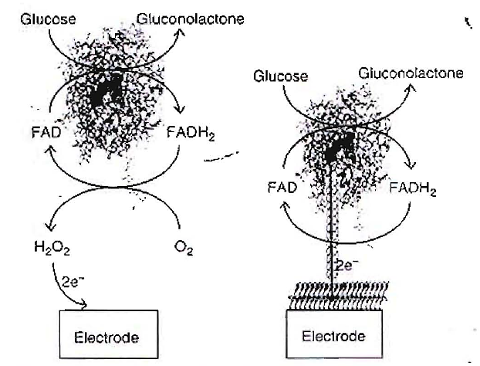
1. Introduction
A classical first generation enzyme electrode using GOx as an example where Glucose is oxidized to gluconolactone and in the process the redox-active center of GOx, FAD to reduced to FADH_{2 .}
The FADH₂ is then oxidized back to FAD by freely diffusing oxygen.
The oxygen is reduced to hydrogen peroxide which is detected at the electrode.
A carbon nanotube is plugged into the enzyme and the reoxidation of the FADH₂ is achieved via direct electron transfer.

Slide 4
1. Introduction
In many commercial glucose biosensors the 0₂/H₂0₂ couple is replaced by a synthetic mediator such as ferrocene.
But the principle of a diffusing species shuttling electrons between the protein and an electrode is the same .
The advantage of CNTs compared to other nanomaterials lies in unique combination of electrical, magnetic, optical, mechanical, and chemical properties, which offer great promises for a wide range of applications, including biosensing.
CNTs can serve as platforms to conjugate other compounds at their surface (exohedral functionalization).
CNTs shells can be opened and filled (endohedral functionalization) without losing their stability.
Functionalized CNTs can effectively cross biological barriers such as the cell membrane and penetrate individual cells.

Slide 5
2. Exohedral and endohedral functionalization of CNTs.
Non-covalent surface functionalization of a bucky tubes with a micellar surfactant or with a shell-like surfactant wrapping around the nanotubes

Slide 6
2. Exohedral and endohedral functionalization of CNTs.
Fullerenes can be used for capping the ends or filling the capillaries

Slide 7
3. Basics of Carbon Nanotubes and Their Electrochemistry
The nanotubes are electrocatalytic allowing electrochemistry of certain biologically important species to be detected at much lower potential than other electrodes.
The nanotubes can have lengths ranging from tens of nanometers to several microns.
Depending on their number of walls, CNTs are designated single walled (SWNTs) or multi-walled (MWNTs).
SWNTs, as the name suggests, consist of a single hollow tube with diameters between 0.4 to 2 nm,
whereas MWNTs are composed of multiple concentric nanotube 0.34 nm apart, where the final MWNT has diameters of 2-100 nm.
Carbon nanotubes can be thought of as all sp² - carbons arranged in graphene sheets that have been rolled up to form a seamless hollow tube.
The tubes can be capped at the ends by a fullerene-type hemisphere, but are often open.

Slide 8
3. Basics of Carbon Nanotubes and Their Electrochemistry
Single-walled Carbon nanotubes (SWNTs) structures in function of their chirality (zigzag, armchair, and chiral).

Slide 9
3. Basics of Carbon Nanotubes and Their Electrochemistry
Structure of multi-walled carbon nanotubes (MWNTs) made up of several concentric shells.

Slide 10
3. Basics of Carbon Nanotubes and Their Electrochemistry
The small size of SWNT important for interfacing with proteins if the nanotubes are to penetrate the outer shell of the protein with a minimization of any disruption of the protein structure.
For example, the entrance on the surface of GOx to the active site is approximately 1 nm in diameter and therefore MWNT with are significantly greater in size than this are unlikely to be effectively integrated with the protein.
SWNTs can be metals, semiconductors. or small-band-gap semiconductors depending on their diameter and chirality.
The chirality of the SWNT relates to the angle at which the graphene sheets roll up and hence the alignment of the π-orbitals.
In SWNTs with a small diameter, approximately two-third exhibit semiconducting properties and one-third are metallic.

Slide 11
3. Basics of Carbon Nanotubes and Their Electrochemistry
Carbon nanotubes are anisotropic, having two physically and chemically distinct regions: the walls and the ends.
Electrochemically active regions are at the open ends of the CNTS which posses variety of oxygenated species.
There are two main approaches to forming aligned carbon nanotube arrays.
The first is to grow aligned nanotubes directly from a surface- typically generates MWNT that are too large to plug to proteins.
New approaches have been developed to grow SWNT directly from a surface.
The alternative approach is to align the carbon nanotubes by self-assembly. (mostly preferred)
The SWNTs were shortened in mixture of concentrated sulfuric acid and concentrated nitric acid in 3:1 ratio.

Slide 12
3. Basics of Carbon Nanotubes and Their Electrochemistry
This oxidative shortening leaves several carboxylic groups at either ends of the tubes.
The carboxylate ends can be converted to carbodiimide leaving groups using 1 g dicyclohexylcarbodiimide (DCC).
This allows reaction with amines to form an amide bond.
Exposure of shortened nanotubes which have had the carboxylic acid groups activated with DCC to a gold electrode modified with a self assembled monolayer of cysteamine results in one end of the nanotubes attaching to the gold electrodes.
This gives an array of SWNTs standing normal to the surface and can be viewed using Atomic force microscopy (AFM).

Slide 13
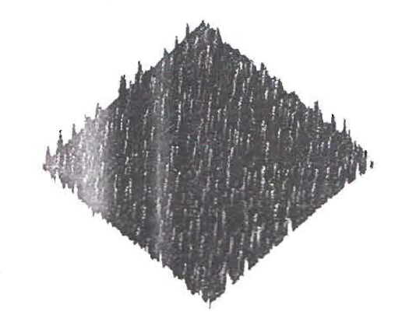
3. Basics of Carbon Nanotubes and Their Electrochemistry
A tapping mode AFM image of aligned carbon nanotube array, formed by self assembly.

Slide 14
Fabrication of enzyme electrodes
Nano scale extension of bulk electrode sufficient small to penetrate into proteins (enzymes).
The distance that electrons must tunnel from redox active center to the electrode is shortened by electrical connections.
Enzymes having redox active centers close to the surface of proteins (enzymes) e.g. MP 11 made of only 11 amino acids and heme redox active center.
It is obtained by proteolytic cleavage of horse heart cytochrome c.

Slide 15
Integrating CNTs with Proteins where redox center is embedded deep within the proteins (Glucose oxidase)
Chance of penetration of nanotube into protein redox center.
Distance between FAD and Surface of enzyme (13 Å).
Enzyme is reconstituted over the end of nanotubes (SWNTs)

Slide 16
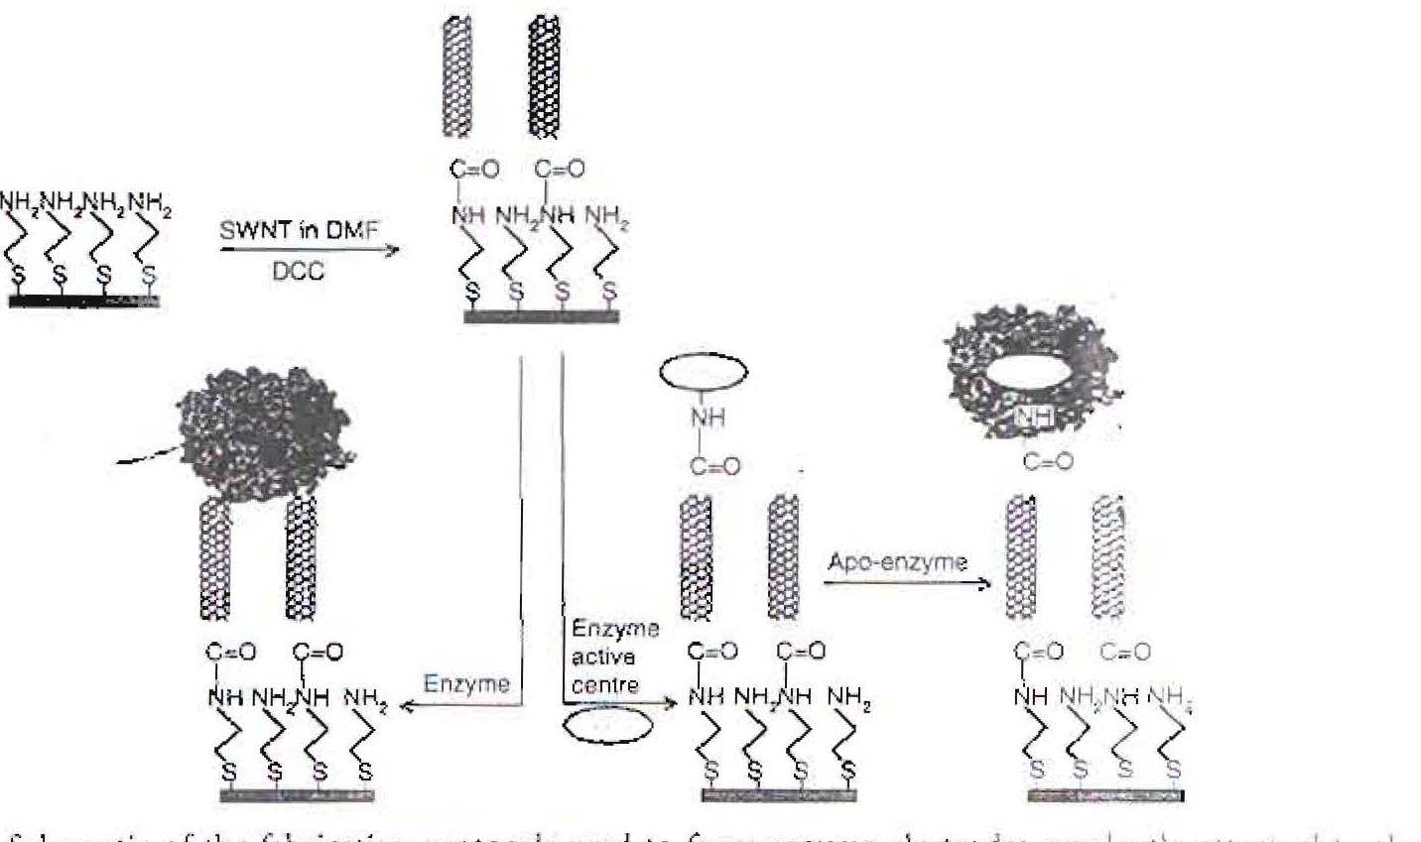
Schematics of the fabrication protocol used to form enzyme electrode covalently attached to ends of SWNT electrode array

Slide 17
4. APPLICATIONS OF CNT (Examples-Biosensing)
SWNT electrically-contacted glucose oxidase electrode.

Slide 18
4. Applications of CNT

Slide 19
4. APPLICATIONS OF CNT (Examples-Biosensing)
Typical design of an enzyme-based electrochemical biosensor.

Slide 20
4. APPLICATIONS OF CNT (Examples-Biosensing)
Schematic illustration of a label-free amperometric biosensor for PSA detection.

